Slide 1
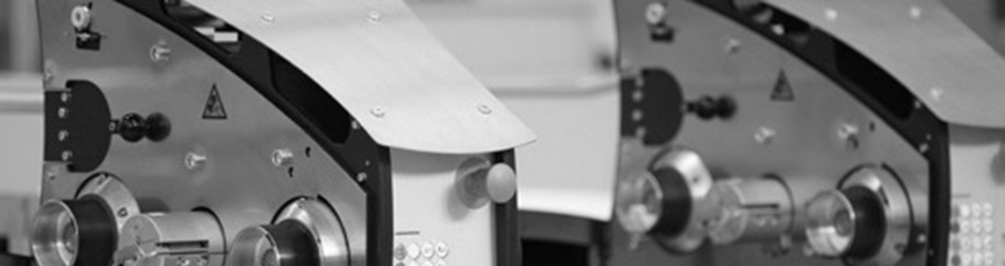
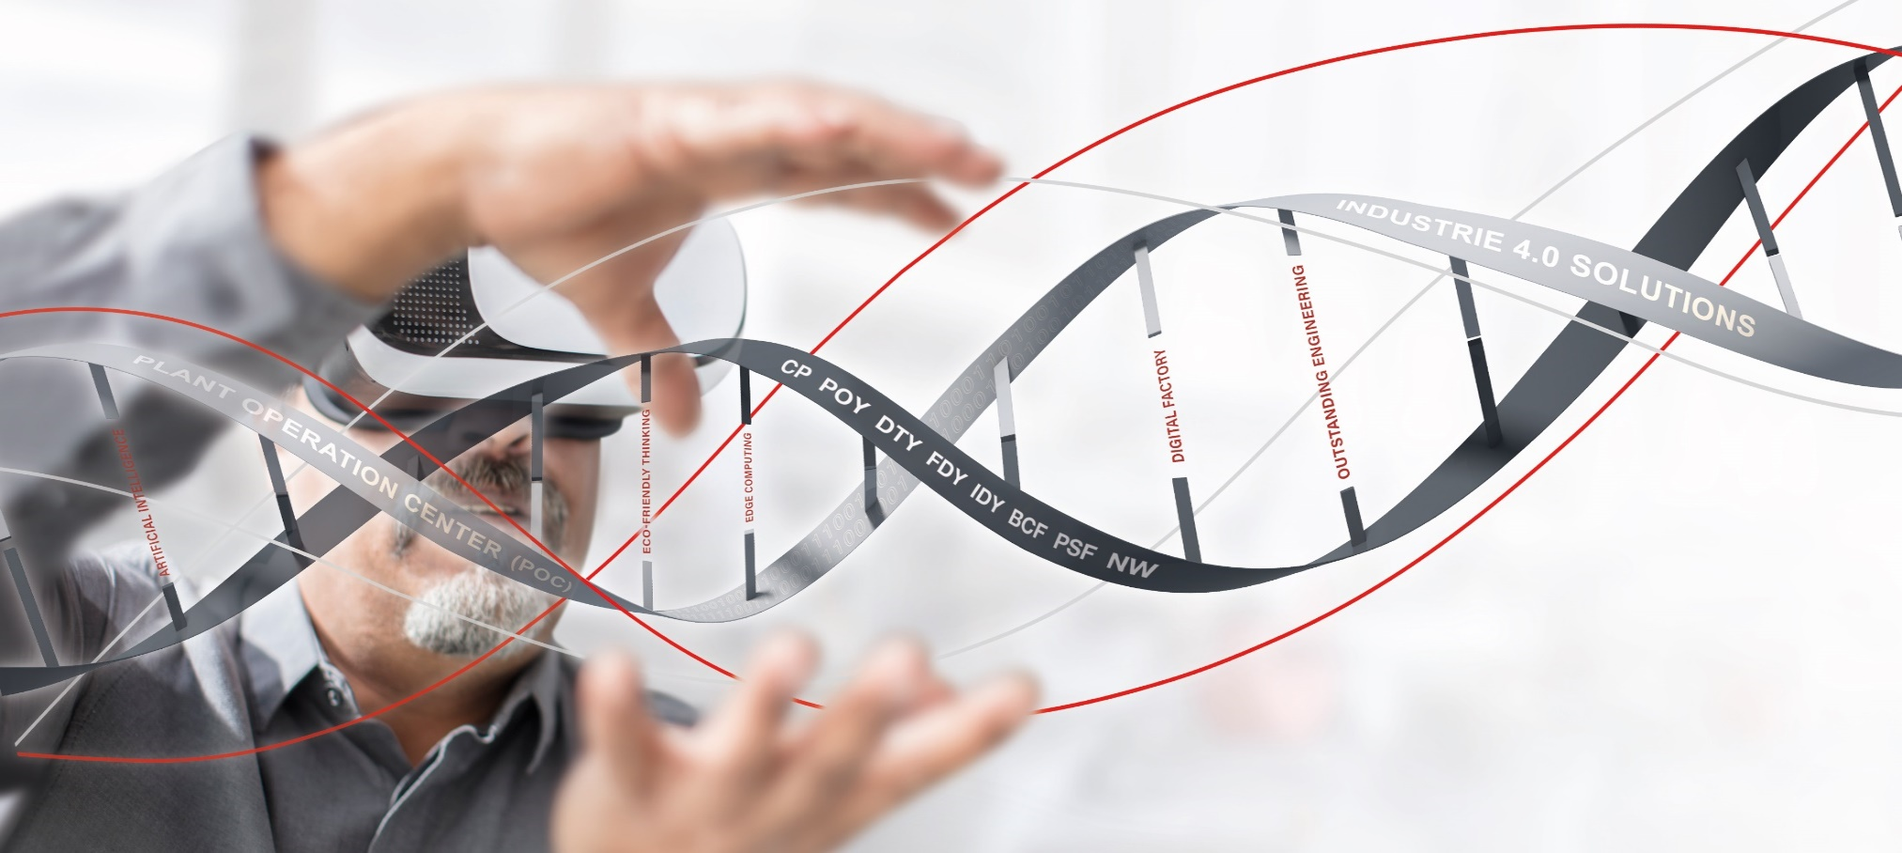
From Melt to Yarn, Fibers and Nonwovens
Clean Technology. Smart Factory.
Oerlikon Polymer Processing Solutions Division
Remscheid
June 2024

Slide 2
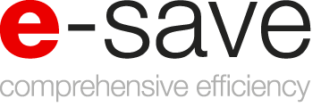









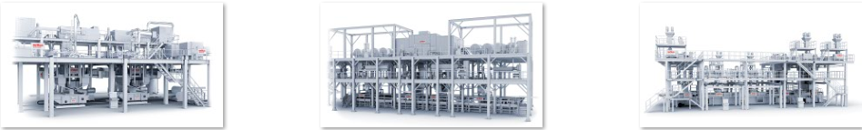
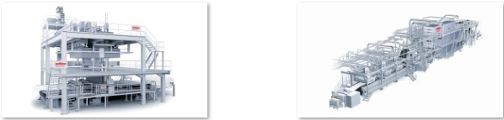

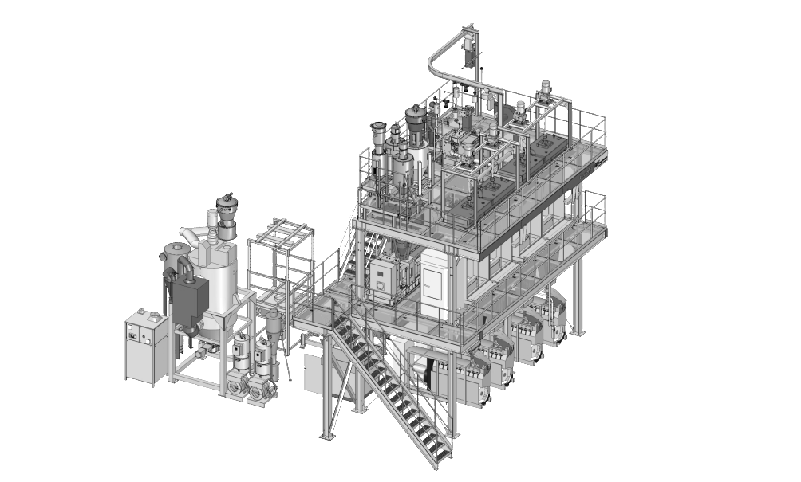
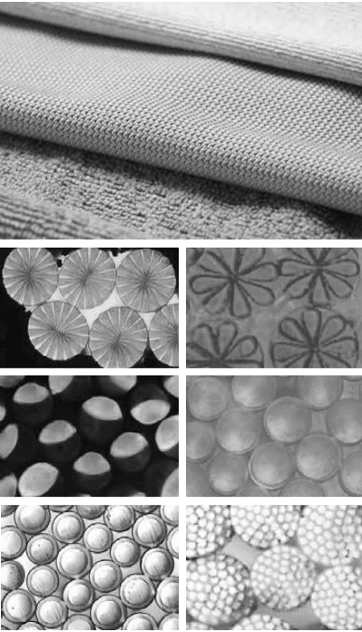


Our Products: From Melt to …
    CP Continuous Polycondensation Plant Solutions
    Filament Yarn (POY/FDY)
      POY spinning with WINGS
      FDY spinning with WINGS
      Compact Filament Spinning Line VarioFil
    Textured Yarn (DTY)
    Industrial Yarn (IDY)
    Carpet Yarn (BCF)
    Staple Fiber
    Nonwoven
    Flow Control Solutions
      Gear Metering Pumps for Manmade Fiber Applications
      Gear Metering Pumps for Non-textile Applications
      Hot Runner Systems
    Automation Solutions
    Digital Solutions
Hot Runner Systems
Polymer Processing Solutions
Continuous Polycondensation (CP)
Extrusion
Filament spinning
Staple fiber
spinning
Nonwovens
POY
FDY
Technical Yarn (IDY)
BCF
Others
Airlaid
Meltblown
Spunbond
DTY
Compact Spinning / Recycling
Bico
Special Winders
Gear Metering Pumps
BBE
Market Overview
Customer Services
Industrie 4.0 / POC / Automation
Financing

Slide 3
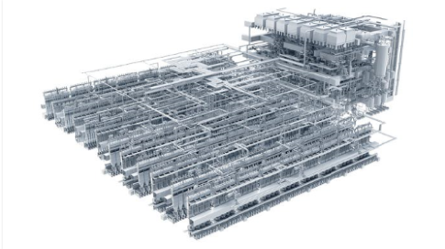
CP Continuous Polycondensation Plant Solutions
    CP Continuous Polycondensation Plant Solutions
    Filament Yarn (POY/FDY)
      POY spinning with WINGS
      FDY spinning with WINGS
      Compact Filament Spinning Line VarioFil
    Textured Yarn (DTY)
    Industrial Yarn (IDY)
    Carpet Yarn (BCF)
    Staple Fiber
    Nonwoven
    Flow Control Solutions
      Gear Metering Pumps for Manmade Fiber Applications
      Gear Metering Pumps for Non-textile Applications
      Hot Runner Systems
    Automation Solutions
    Digital Solutions
              Polymer Processing
              Homogenous melt is the very basis for high quality yarn and all other plastic materials. Producing this is the job of our efficient and high-end continuous polycondensation systems and extrusions lines for fiber-grade and bottle-grade polyester as well as other polymers. Whereas polycondensation plants produce the melt by a chemical reaction, extrusion produces the melt by a mechanical process. The choice of polycondensation or extrusion depends on many factors including the production rate, the nature of the material and the size of the final product. The efficient and high-end continuous polycondensation plants of the subsidiary company Oerlikon Barmag Huitong Engineering (OBHE) produce a homogenous melt using a chemical reaction which transfers different monomers into polymers.
              >> more
>> Picture download CP Solutions

Slide 4
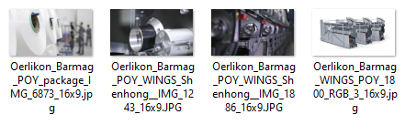


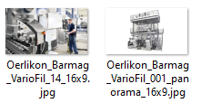
Filament Yarn (POY/FDY)
    CP Continuous Polycondensation Plant Solutions
    Filament Yarn (POY/FDY)
      POY spinning with WINGS
      FDY spinning with WINGS
      Compact Filament Spinning Line VarioFil
    Textured Yarn (DTY)
    Industrial Yarn (IDY)
    Carpet Yarn (BCF)
    Staple Fiber
    Nonwoven
    Flow Control Solutions
      Gear Metering Pumps for Manmade Fiber Applications
      Gear Metering Pumps for Non-textile Applications
      Hot Runner Systems
    Automation Solutions
    Digital Solutions
              POY spinning with WINGS
              Pre-oriented yarns (POY) are the starting material for a wide range of fashion, sports, functional and home textiles. Following production, POY yarns are textured and – with around 40 percent – make up the lion’s share of the global production of manmade fiber yarns.
              FDY spinning with WINGS
              Fully-drawn yarns (FDY) are used to manufacture textile fabrics without the need for further finishing. Wherever textiles are to hang smoothly or glide fully-drawn yarns are used.
              Compact Filament Spinning Line VarioFil
              VarioFil is the ideal production unit for manufacturers that have a wide range of products, small lot numbers or specialised products. The VarioFil unit is not limited to using only one material or a particular process. Customised conversion packages allow the unit to be adjusted to the market requirements quickly and at reasonable rates.
              >> more
>> Picture download Filament Yarn

Slide 5

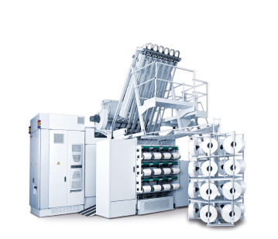
Textured Yarn (DTY)
    CP Continuous Polycondensation Plant Solutions
    Filament Yarn (POY/FDY)
      POY spinning with WINGS
      FDY spinning with WINGS
      Compact Filament Spinning Line VarioFil
    Textured Yarn (DTY)
    Industrial Yarn (IDY)
    Carpet Yarn (BCF)
    Staple Fiber
    Nonwoven
    Flow Control Solutions
      Gear Metering Pumps for Manmade Fiber Applications
      Gear Metering Pumps for Non-textile Applications
      Hot Runner Systems
    Automation Solutions
    Digital Solutions
              Solutions for DTY production
              Texturing is a finishing step that transforms the POY supply yarn into DTY and hence into an attractive and unique product.
              Apparel, home textiles, automotive – there are countless applications for textured yarns manufactured on Oerlikon Barmag machines. Correspondingly specific are the demands made on the yarns used.
              During texturing, pre-oriented yarn (POY) is permanently crimped using friction. As a result, elasticity and heat retention are increased, the yarn receives a pleasant handle, while thermal conduction is simultaneously reduced.
              >> more
>> Picture download Textured Yarn

Slide 6

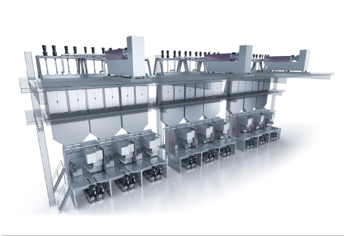
Industrial Yarn (IDY)
    CP Continuous Polycondensation Plant Solutions
    Filament Yarn (POY/FDY)
      POY spinning with WINGS
      FDY spinning with WINGS
      Compact Filament Spinning Line VarioFil
    Textured Yarn (DTY)
    Industrial Yarn (IDY)
    Carpet Yarn (BCF)
    Staple Fiber
    Nonwoven
    Flow Control Solutions
      Gear Metering Pumps for Manmade Fiber Applications
      Gear Metering Pumps for Non-textile Applications
      Hot Runner Systems
    Automation Solutions
    Digital Solutions
              Industrial Yarn (IDY)
              With a operation window of between 50 and 12,000 den per filament, Oerlikon Barmag industrial yarn systems cover an extremely-wide titer range. Depending on the application and the required yarn characteristics, Oerlikon Barmag systems produce ‘strong’ yarns for all applications: from high-tenacity high-modulus yarn for safety belts, HMLS yarns for tire cords all the way through to low and ultra-low shrinkage yarns for tarpaulins.
              >> more
>> Picture download Industrial Yarn

Slide 7

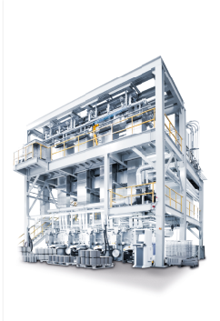
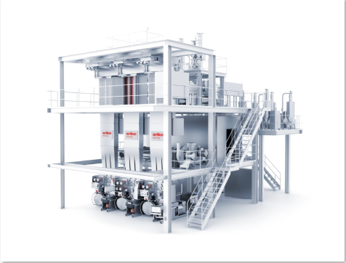
Carpet Yarn (BCF)
    CP Continuous Polycondensation Plant Solutions
    Filament Yarn (POY/FDY)
      POY spinning with WINGS
      FDY spinning with WINGS
      Compact Filament Spinning Line VarioFil
    Textured Yarn (DTY)
    Industrial Yarn (IDY)
    Carpet Yarn (BCF)
    Staple Fiber
    Nonwoven
    Flow Control Solutions
      Gear Metering Pumps for Manmade Fiber Applications
      Gear Metering Pumps for Non-textile Applications
      Hot Runner Systems
    Automation Solutions
    Digital Solutions
              BCF Carpet Yarn Technology
              „Mastering the entire carpet yarn production process“
              With the BCF plants BCF S8, S+ and Sytec One, Oerlikon Neumag offers a product portfolio in which the customer is certain to find the plant designed to meet their individual needs.
              >> more
>> Picture download Carpet Yarn

Slide 8
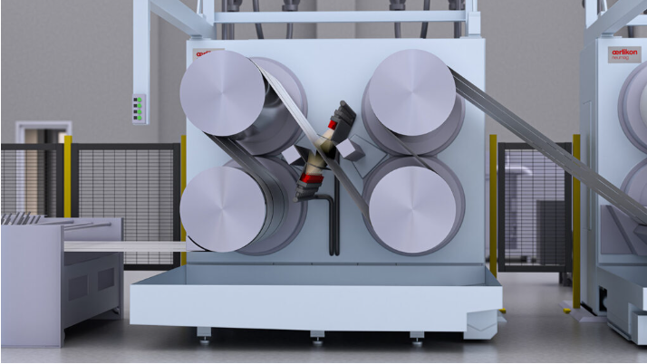
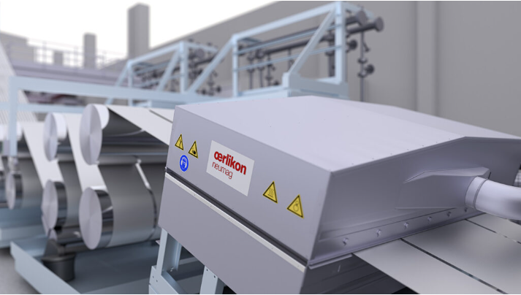
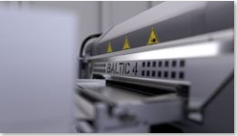
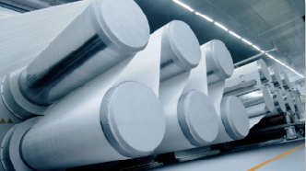
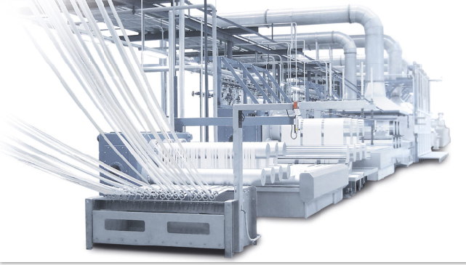
Staple Fiber
    CP Continuous Polycondensation Plant Solutions
    Filament Yarn (POY/FDY)
      POY spinning with WINGS
      FDY spinning with WINGS
      Compact Filament Spinning Line VarioFil
    Textured Yarn (DTY)
    Industrial Yarn (IDY)
    Carpet Yarn (BCF)
    Staple Fiber
    Nonwoven
    Flow Control Solutions
      Gear Metering Pumps for Manmade Fiber Applications
      Gear Metering Pumps for Non-textile Applications
      Hot Runner Systems
    Automation Solutions
    Digital Solutions
              Staple Fiber Plant Solutions
              More than 4 million tons installed production capacity worldwide speak for themselves.
              Oerlikon Neumag staple fiber plants stand for highest product quality and absolute reliability.
              Oerlikon Neumags compact 1-step staple fiber spinning lines have an excellent flexibility with regard to the processable raw materials and titer range.
              Oerlikon Neumag´s two-step staple fiber plants are designed to meet highest quality requirements at minimum operation cost.
              The new EvoSteam process for cotton type fiber production. EvoSteam process dispenses with liquid bath, Improving the fiber qualities through optimized draw point release
              >> more
>> Picture download Staple Fiber

Slide 9
Nonwoven
    CP Continuous Polycondensation Plant Solutions
    Filament Yarn (POY/FDY)
      POY spinning with WINGS
      FDY spinning with WINGS
      Compact Filament Spinning Line VarioFil
    Textured Yarn (DTY)
    Industrial Yarn (IDY)
    Carpet Yarn (BCF)
    Staple Fiber
    Nonwoven
    Flow Control Solutions
      Gear Metering Pumps for Manmade Fiber Applications
      Gear Metering Pumps for Non-textile Applications
      Hot Runner Systems
    Automation Solutions
    Digital Solutions
              Nonwoven
              As an engineering company for a wide range of nonwoven technologies, Oerlikon Nonwoven provides stand-alone machines and turnkey production lines for almost every type of nonwoven product.
              Oerlikon Nonwoven offers flexible, high-performance technologies for Meltblown, Spunbond and Airlaid.
              >> more
              >> more
>> Picture download Nonwoven

Slide 10
Flow Control
    CP Continuous Polycondensation Plant Solutions
    Filament Yarn (POY/FDY)
      POY spinning with WINGS
      FDY spinning with WINGS
      Compact Filament Spinning Line VarioFil
    Textured Yarn (DTY)
    Industrial Yarn (IDY)
    Carpet Yarn (BCF)
    Staple Fiber
    Nonwoven
    Flow Control Solutions
      Gear Metering Pumps for Manmade Fiber Applications
      Gear Metering Pumps for Non-textile Applications
      Hot Runner Systems
    Automation Solutions
    Digital Solutions
              Flow Control Equipment
              Oerlikon has a high precision flow control components business that offers a large selection of gear metering pumps for the textile and other industries, including the automotive, chemical and paint markets. With Oerlikon HRSflow the division develops innovative hot runner systems for the polymer processing industry. In cooperation with Oerlikon Balzers, highly efficient and effective coating solutions are offered here from a single source.
              Oerlikon Barmag gear metering pumps are used worldwide as process engineering components in applications involving chemicals, plastics, paints and dyes as well as PUR.
              Pumps for Manmade Fiber Applications
  Gear metering pumps in textile manufacturing are extremely popular. This is above all due to the fact that numerous systems are being modernized in terms of their efficiency and specialization. And it is precisely here that Oerlikon Barmag pumps are deployed, as we have the perfect solution for every application.
  Spinning Pumps for Manmade Fibers
  Spinning pumps for special fibers
  Spin finish pumps for Manmade Fibers
  Dosing Pumps for Additives & Dyes
              Pumps for Non-textile Applications
  Metering Pumps for Polymer Extrusion
  Metering Pumps for Paints
  Metering Pumps for Chemicals
  Metering Pumps for Multi-Purpose Applications
  Metering Pumps for PUR
  Metering Pumps for Composites
  Metering Pumps for Hot-Melt Adhesives
  Metering Pumps for Silicones
  Metering Pumps for Oils
  Eccentric Screw Pumps for Filled Media
Hot Runner Systems
Oerlikon HRSflow develops innovative hot runner systems for the polymer processing industry. In cooperation with Oerlikon Balzers, highly efficient and effective coating solutions are offered here from a single source.
  >> more

Slide 11
Automation Solutions
    CP Continuous Polycondensation Plant Solutions
    Filament Yarn (POY/FDY)
      POY spinning with WINGS
      FDY spinning with WINGS
      Compact Filament Spinning Line VarioFil
    Textured Yarn (DTY)
    Industrial Yarn (IDY)
    Carpet Yarn (BCF)
    Staple Fiber
    Nonwoven
    Flow Control Solutions
      Gear Metering Pumps for Manmade Fiber Applications
      Gear Metering Pumps for Non-textile Applications
      Hot Runner Systems
    Automation Solutions
    Digital Solutions
              Automation along the textile value chain
              Our aim is to make life easier for our customers. That is why we automate work processes on our machines and systems wherever possible and sensible. The focus here is on yarn handling, occupational safety and ergonomics.
              Wiping Robot
              The wiping robot guarantees outstanding yarn quality with a high degree of efficiency and optimized systems management. As a result, yarn manufacturers can minimize costs and maximize profits. How is this possible? It’s really quite simple: conventionally, the wiping process is sweat-inducing work. By automating it, yarn manufacturers can not only increase the full package rate and reduce the yarn break rate – they can also minimize the deployment of staff at the spin packs and produce less waste, hence supporting their HSE (Health – Safety – Environment) initiatives.
              Intralogistics solutions
              Together with our partner IG Automation GmbH, we offer comprehensive solutions in the field of intralogistics.
Doffing systems for spinning machines
Doffing for texturing machines
Transport
Intermediate storage systems
Automatic packing
Pallet finishing
High bay - highly effective
Automatic bobbin sorting and quality control
>> more
>> Picture download Automation Solutions

Slide 12
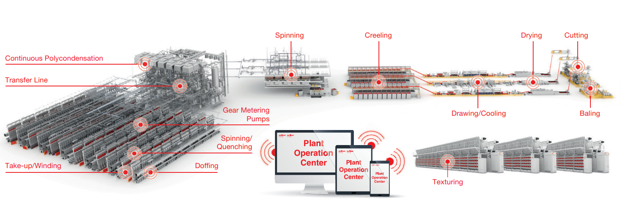
Digital Solutions
    CP Continuous Polycondensation Plant Solutions
    Filament Yarn (POY/FDY)
      POY spinning with WINGS
      FDY spinning with WINGS
      Compact Filament Spinning Line VarioFil
    Textured Yarn (DTY)
    Industrial Yarn (IDY)
    Carpet Yarn (BCF)
    Staple Fiber
    Nonwoven
    Flow Control Solutions
      Gear Metering Pumps for Manmade Fiber Applications
      Gear Metering Pumps for Non-textile Applications
      Hot Runner Systems
    Automation Solutions
    Digital Solutions
              Oerlikon Polymer Processing Solutions Divisions software for your success.
  The digital factory is already reality:
  Datacenter in a box
  Plant Operation Center (POC/atmos.io)
  Fully Automated System (FAUS)
  Artificial Intelligence Manufacturing (AIM)
  >> more
>> Picture download Digital Solutions

Slide 13

Thank you Kontakt
For further information, please contact
Locations | Oerlikon
Or mail to:
Oerlikon Polymer Processing Solutions Division

